Slide 1

LARC: Enhancing Viral Load Cascade Through Lab-Clinic Interface
WHAT IS LARC*?
LARC is a data-driven, process improvement program designed to enhance healthcare service delivery through multidisciplinary teamwork using a quality improvement approach.
The program’s purpose is two-fold:
To strengthen the viral load cascade to achieve better patient result (i.e., viral load suppression)
To improve institutional capability for viral load scale-up
Viral Load Cascade
Demand Creation for Testing
Specimen Collection and Processing
Sample Transport
Laboratory Testing
Result Reporting and Patient Management
Lab-Clinic Interface
Lab-Clinic Interface
LARC focuses on Demand Creation, Result Reporting, and Client Management.
Zimbabwe Implementation Process (October 2019 – December 2020)
Introductory Webinar
Smart Start
(on site)
Learning Session I
Learning Session II
Learning Session III
Harvest Meeting
May 2018
Aug
2018
Aug 2018
Action Period
Action Period
Action Period
LARCcqi.org
*Laboratory African Regional Collaborative

Slide 2
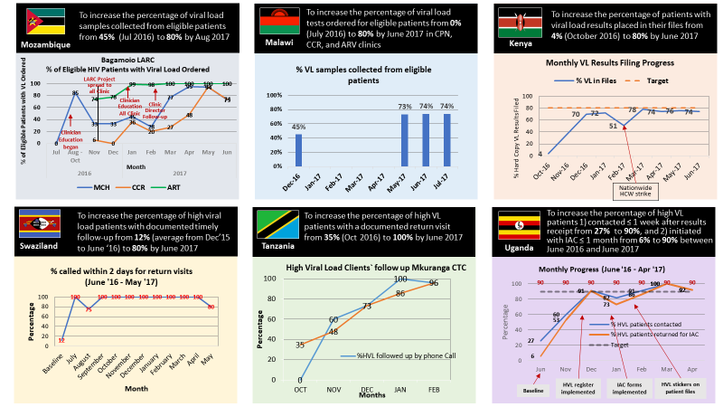

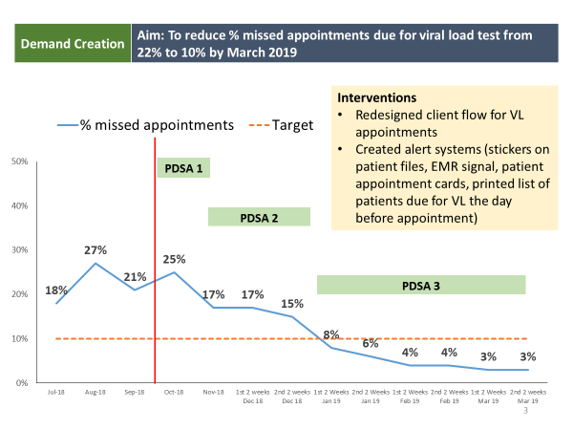
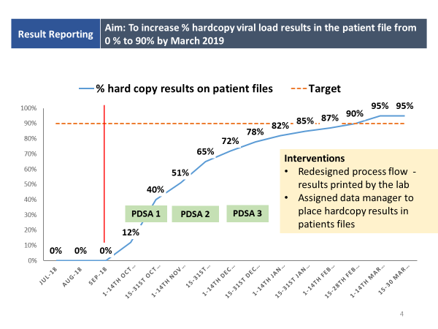
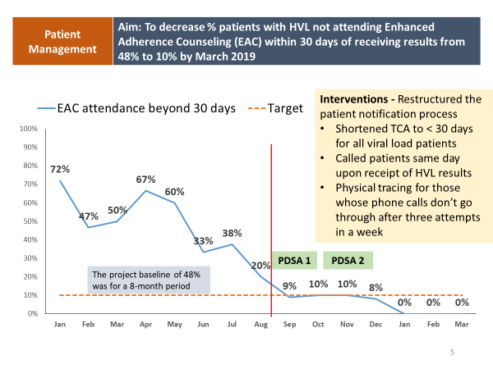
Results from LARC 1.0 (6 countries), 2016-2017
Sample Results from LARC 2.0 (Kenya), 2018-2019

